Slide 1
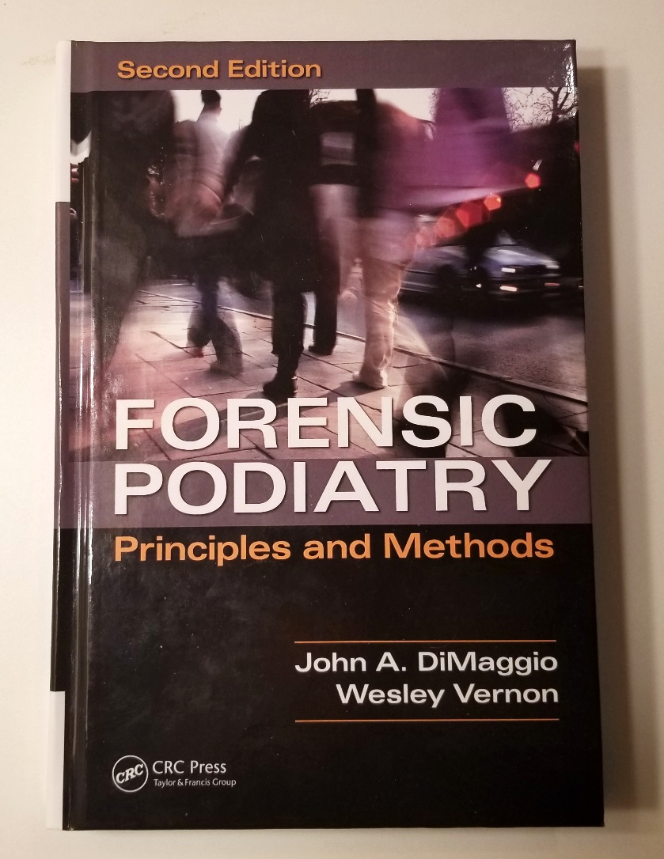

Principles of Pedal Evidence

Slide 2
Forensic Podiatry
The scientific application of podiatry and forensic science to address a legal issue related to feet, gait, footwear or footprints.

Slide 3

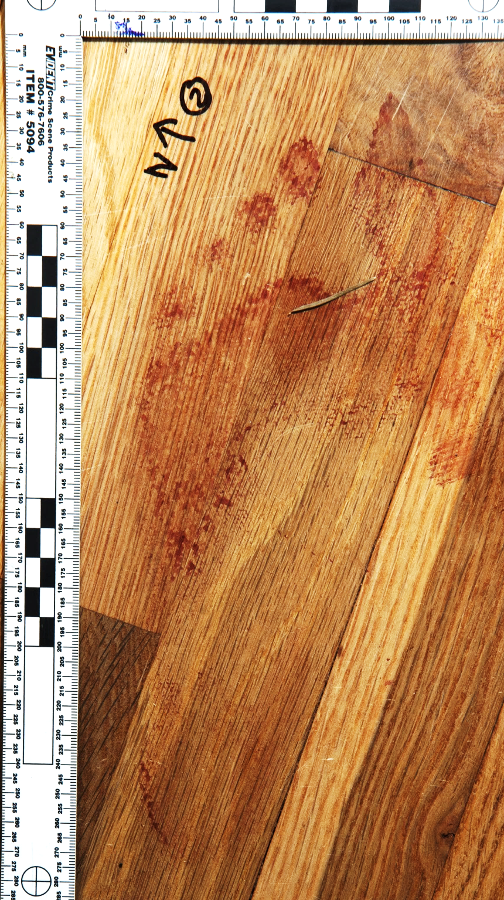
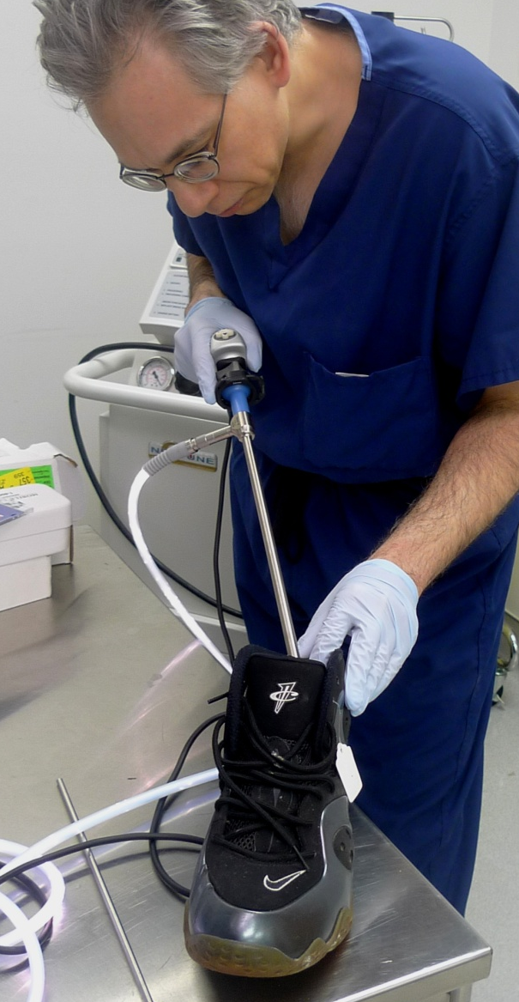
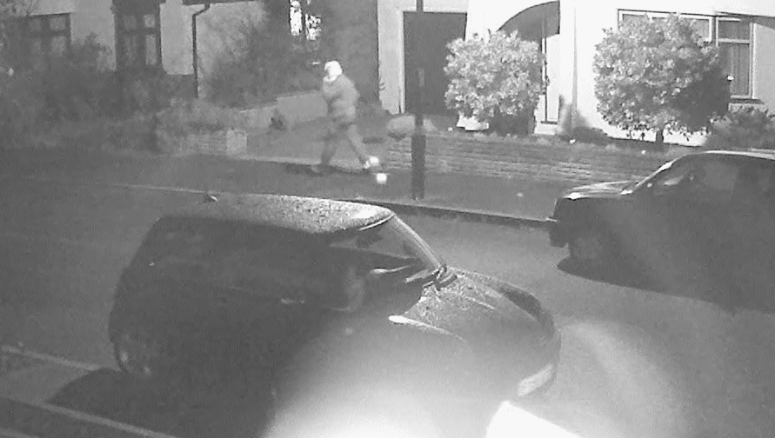
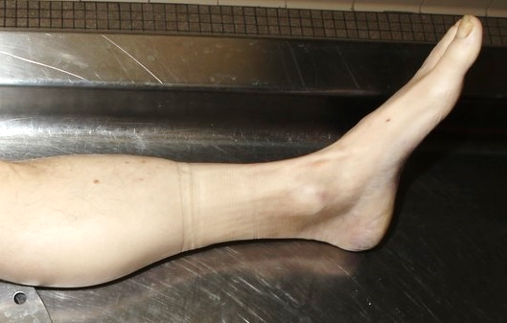
Forensic Podiatry
Case Areas
CCTV photo - FGA Services.
Post-Mortem photo - Wisconsin Crime Lab
Footprint photo – Bothel, WA Police

Slide 4
History (Brief)
1862 Bloody Footprint Scotland
Muir 1935 Ainhum 5th toe case
Norman Gunn 1971 - 2005 (Canada)
Valmassy and Smith
DiMaggio 1989 (USA)
Sara Jones 1990s (Australia)
Haydn Kelly 2000 (UK)
American Society of Forensic Podiatry 2003

Slide 5
American Society of Forensic Podiatry
“…promote the use of podiatry in forensics cases, utilizing the analysis and evaluation of evidence related to the human foot…”
www.theasfp.org

Slide 6
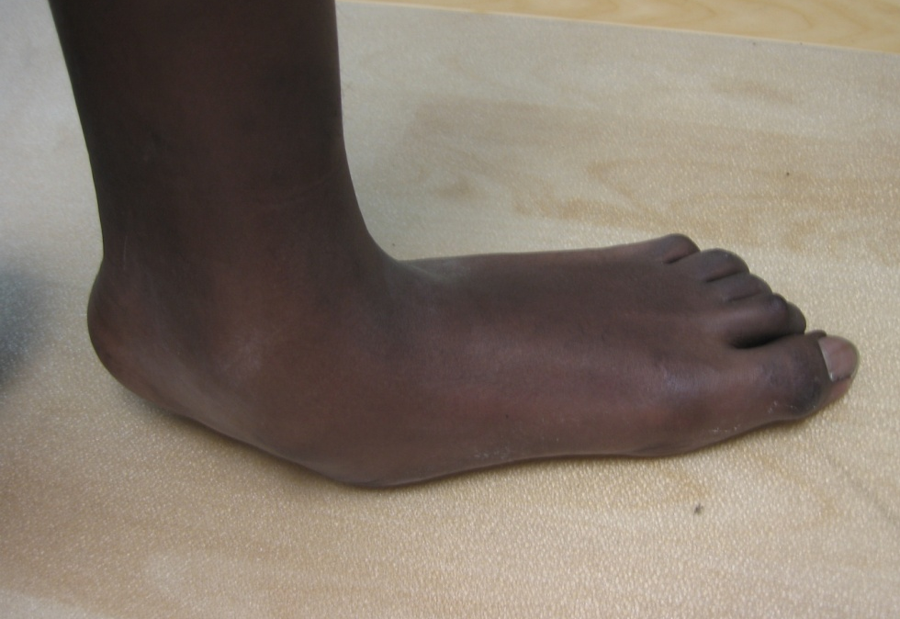
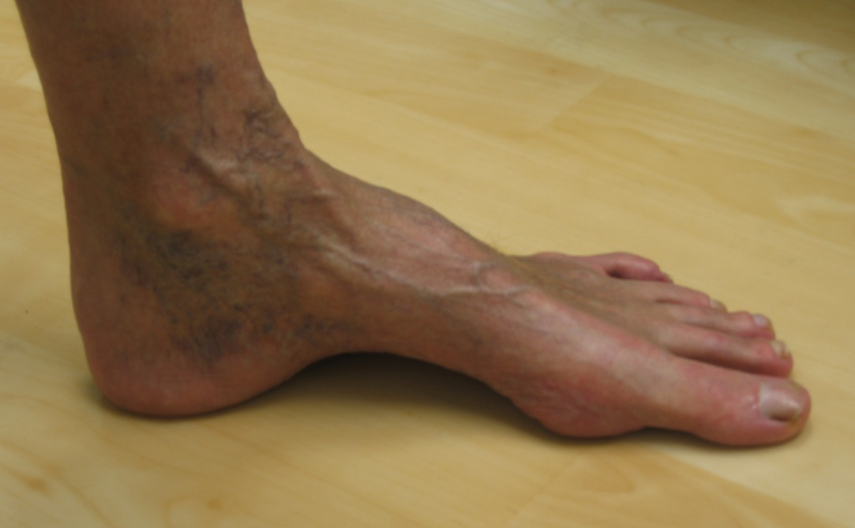
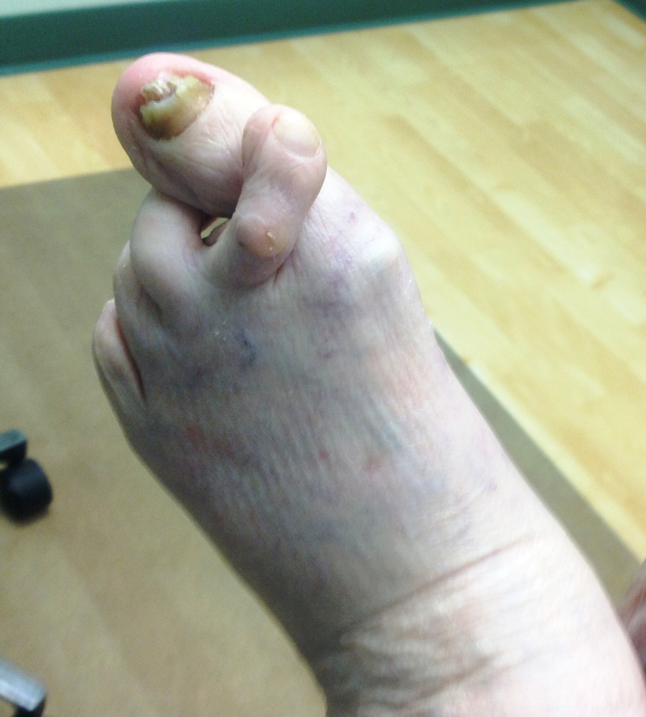
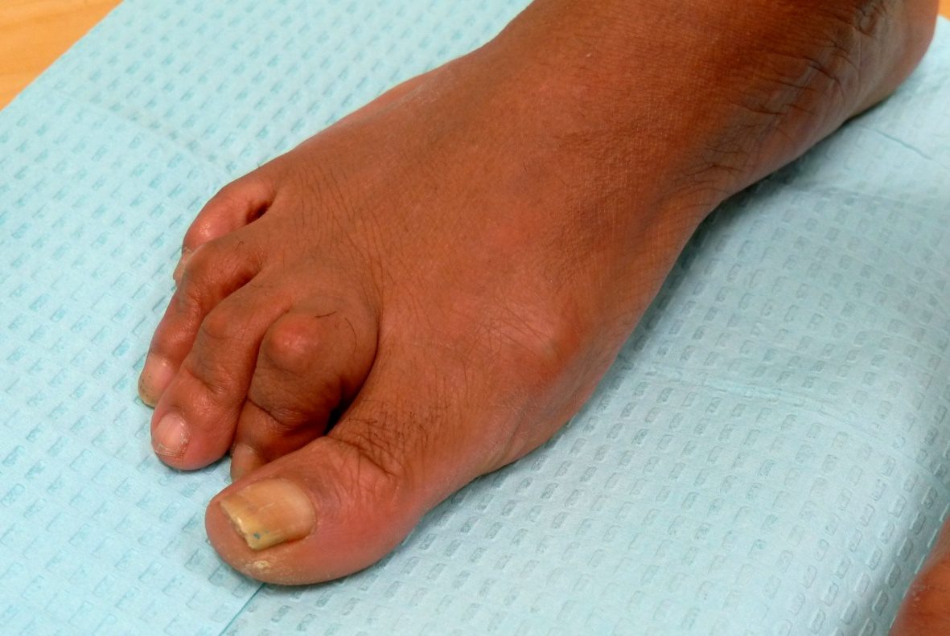
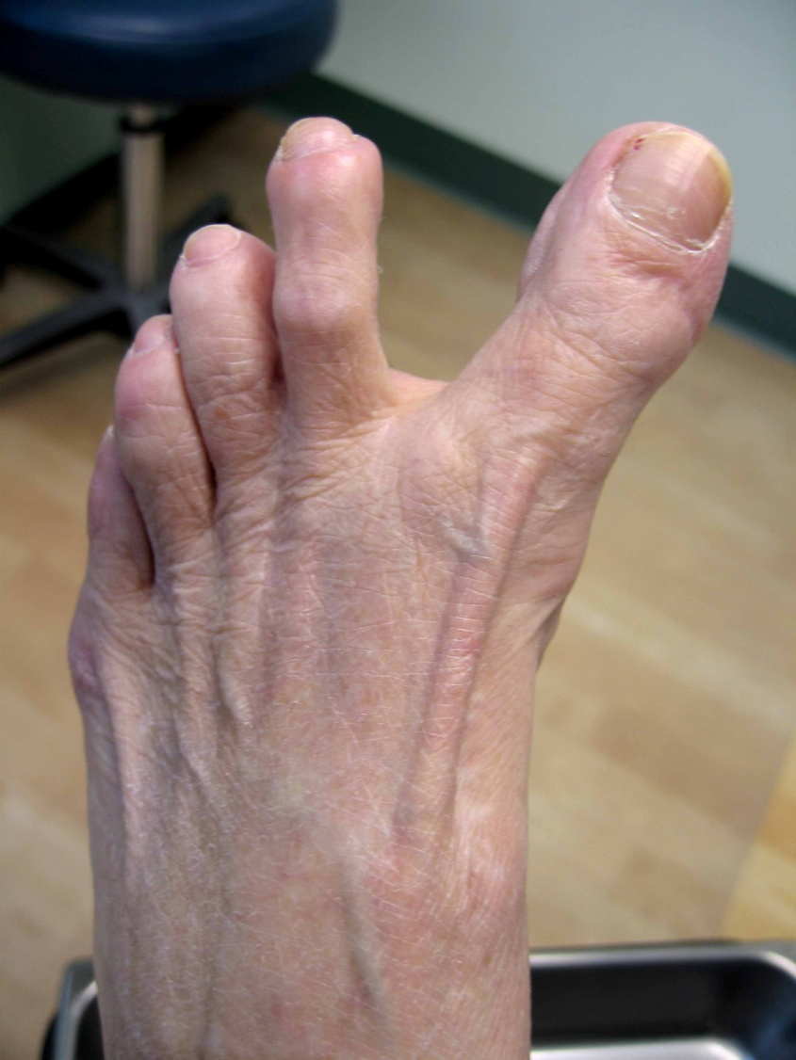
Foot Variation/Pathology

Slide 7
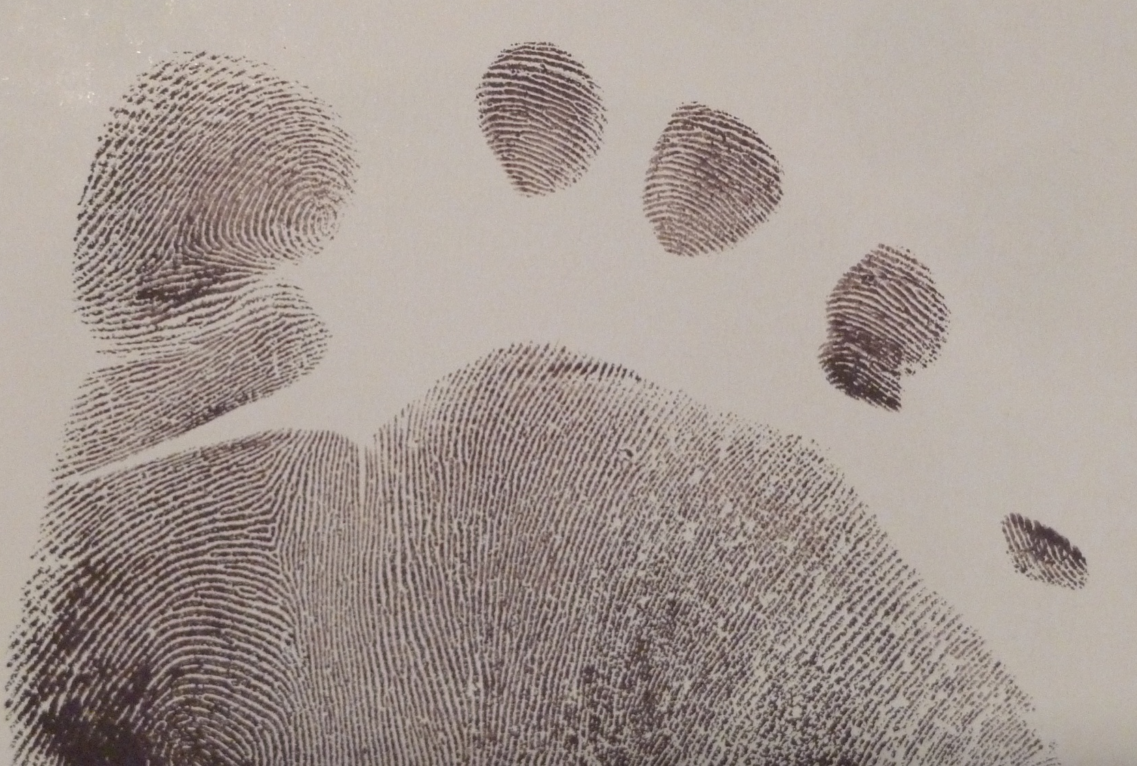
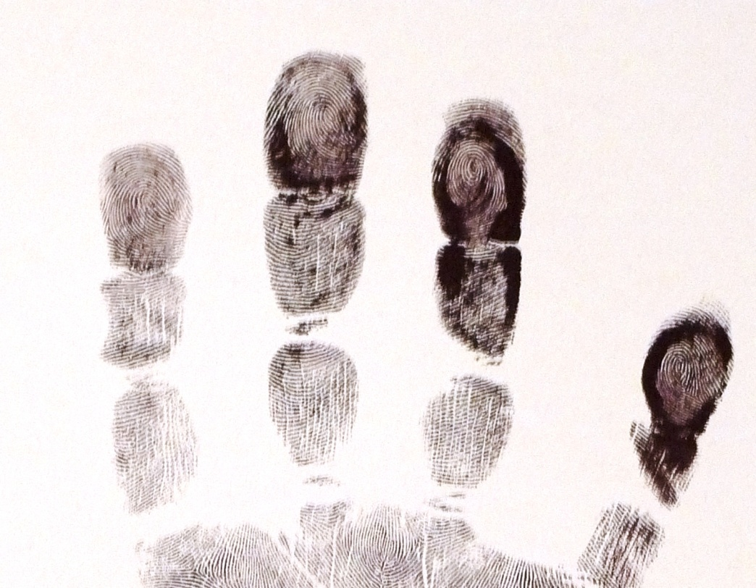
Footprints Have Dermal Ridges

Slide 8
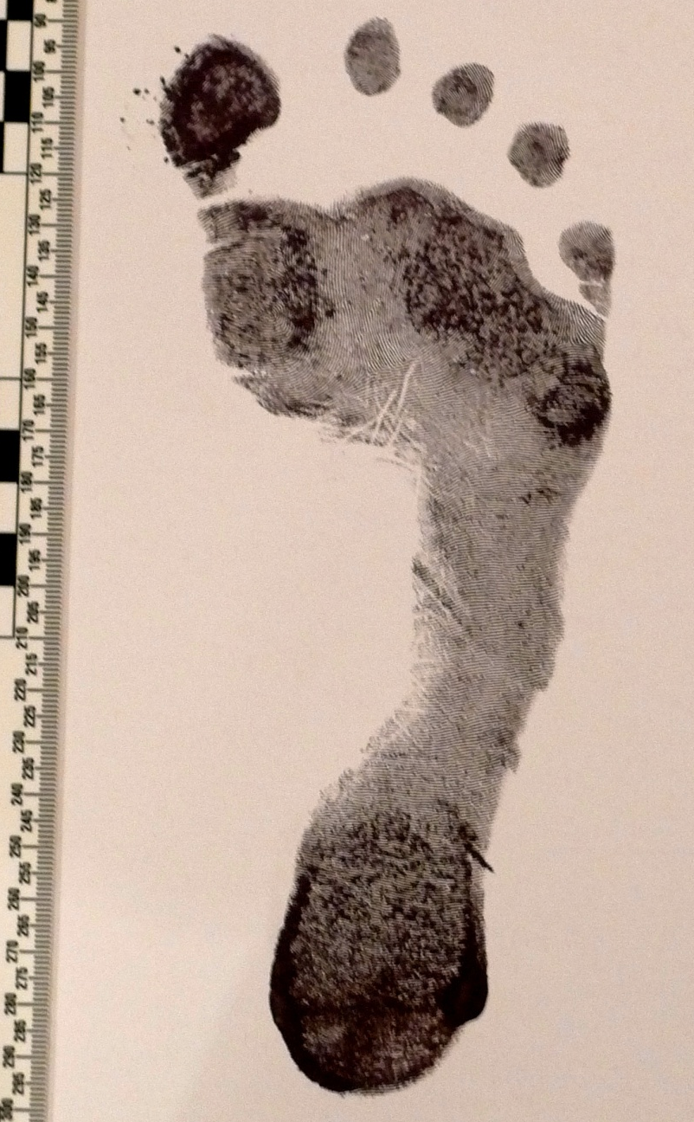

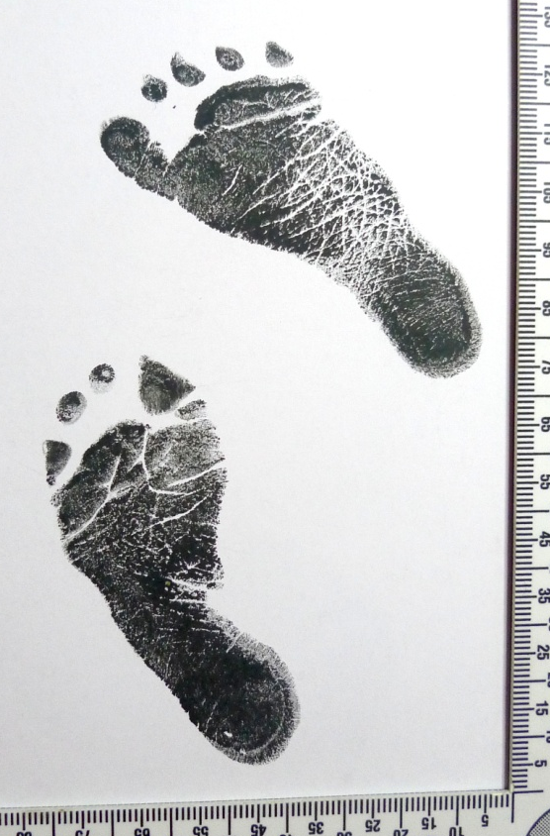
Feet May Have Skin Creases
9 days old
9 years old
Image on left By Pawel Loj (Flickr: mutant) [CC BY 2.0 (http://creativecommons.org/licenses/by/2.0)], via Wikimedia Commons

Slide 9
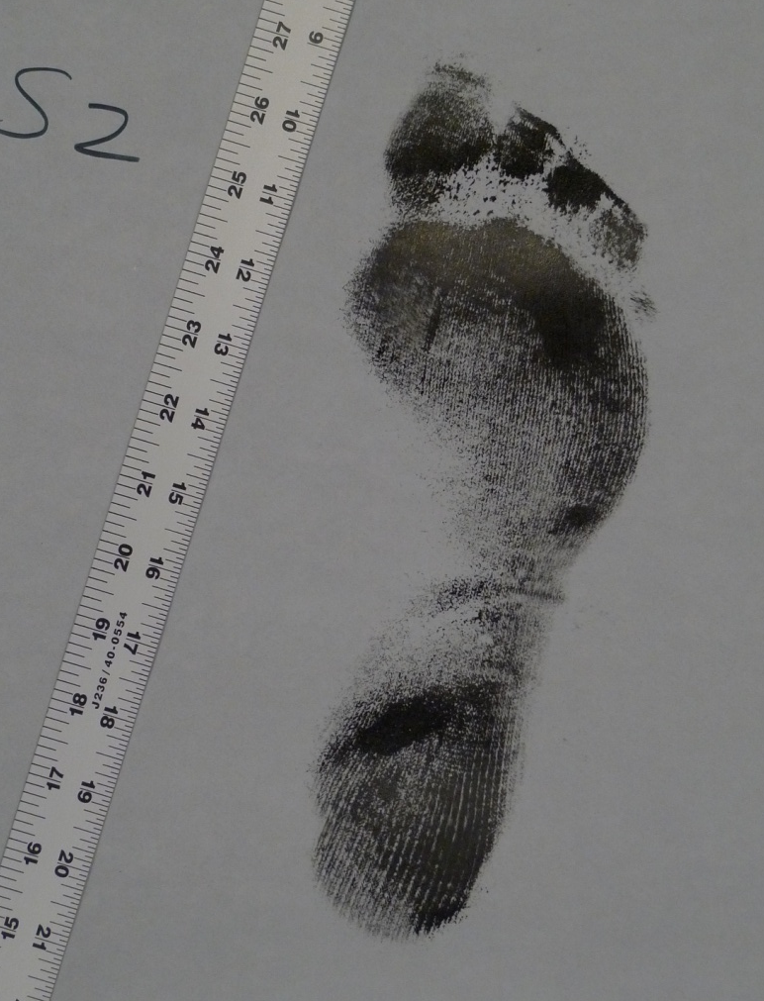
State of Wisconsin vs. Mr. Travis Petersen
Footprint Evidence

Slide 10
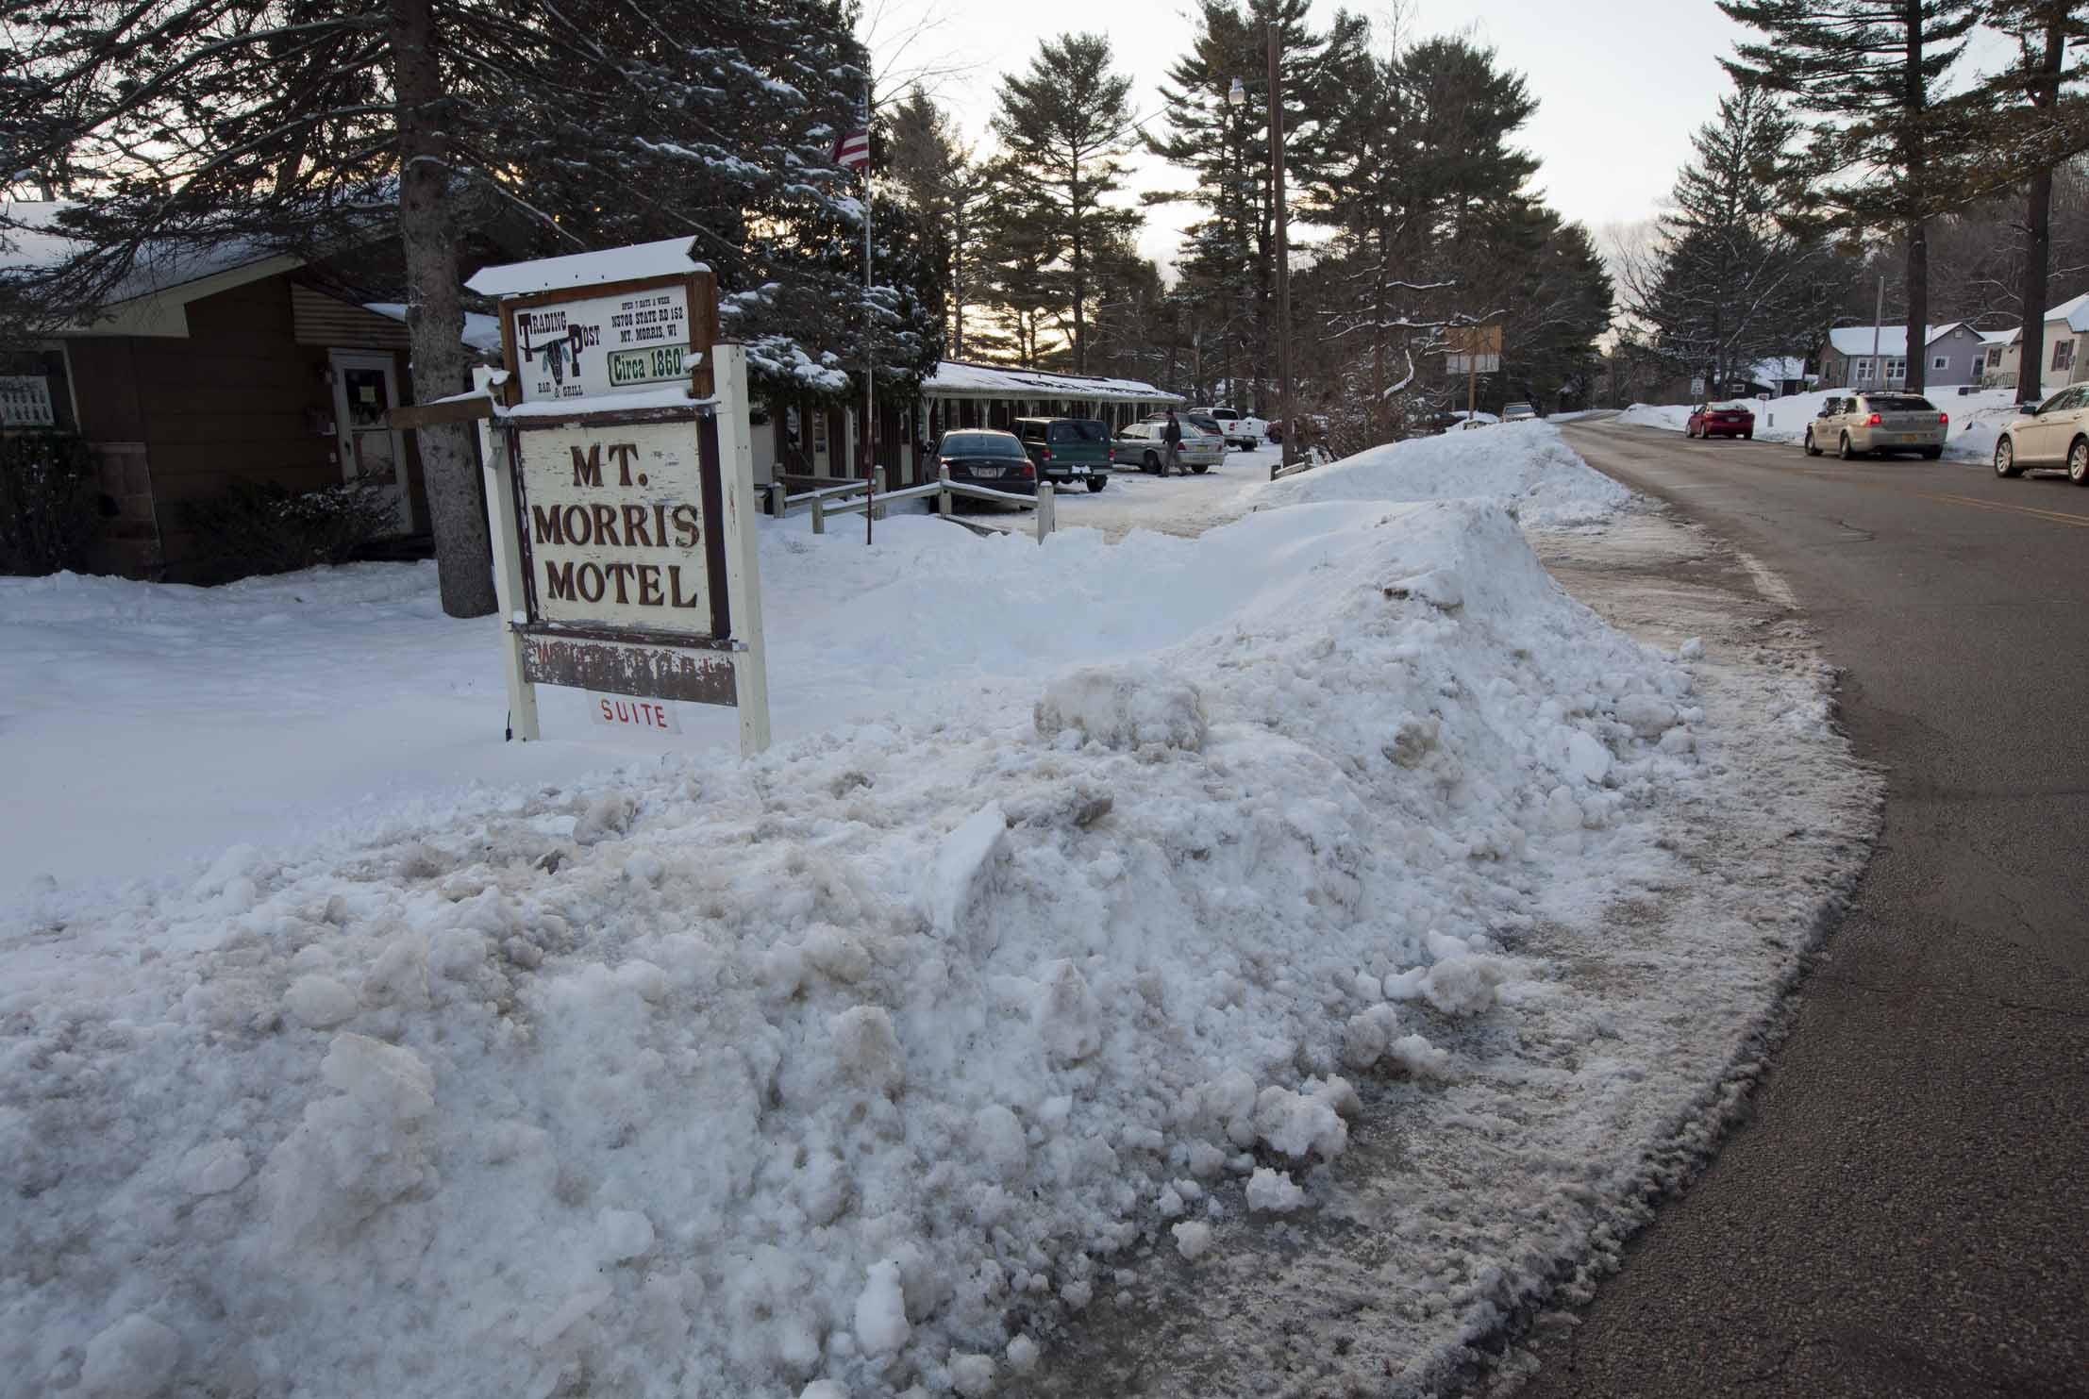
March 2013 Waushara, Wisconsin
Image by Wisconsin State Crime Lab

